Slide 1
COVID-19 Statistics & After-Effects
VISHAL

Slide 2

COVID-19 Statistics
Worldwide Cases
Total Cases
Worldwide Deaths
Total Deaths
New Cases (per day avg.)
New Cases Per Million (avg.)
New Deaths (per day avg.)
New Deaths Per Million (avg.)
People Fully Vaccinated
People Vaccinated Per Hundred (avg.)
Stringency Index (avg.)
Positive Rate (avg.)
Tests Per Case (avg.)

Slide 3
COVID-19 Worldwide Cases
Worldwide COVID-19 reported cases from January 2020 to May 2022

Slide 4
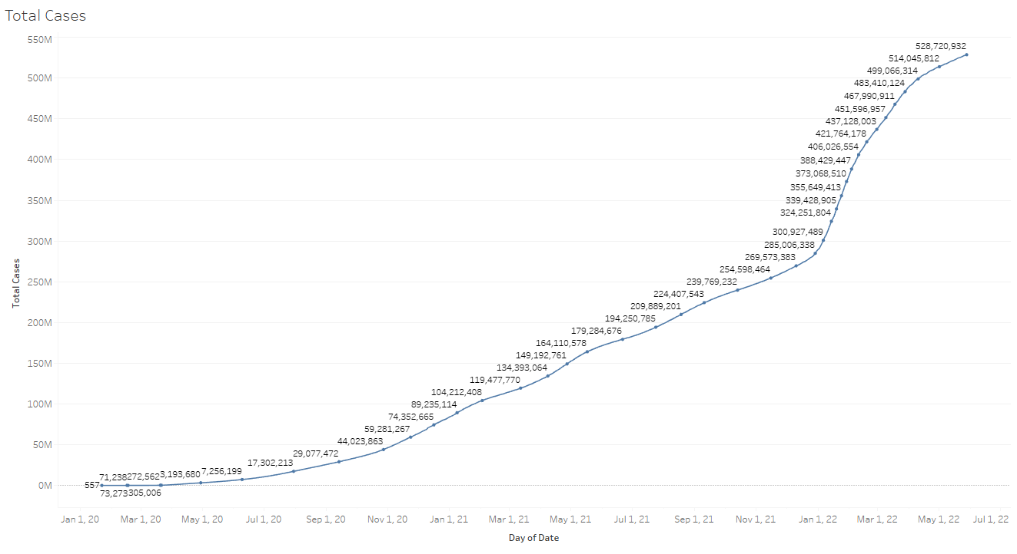
COVID-19 Worldwide Cases

Slide 5
COVID-19 Total Cases
Reported cases in China, India, Russia and USA from 2020 to 2022

Slide 6
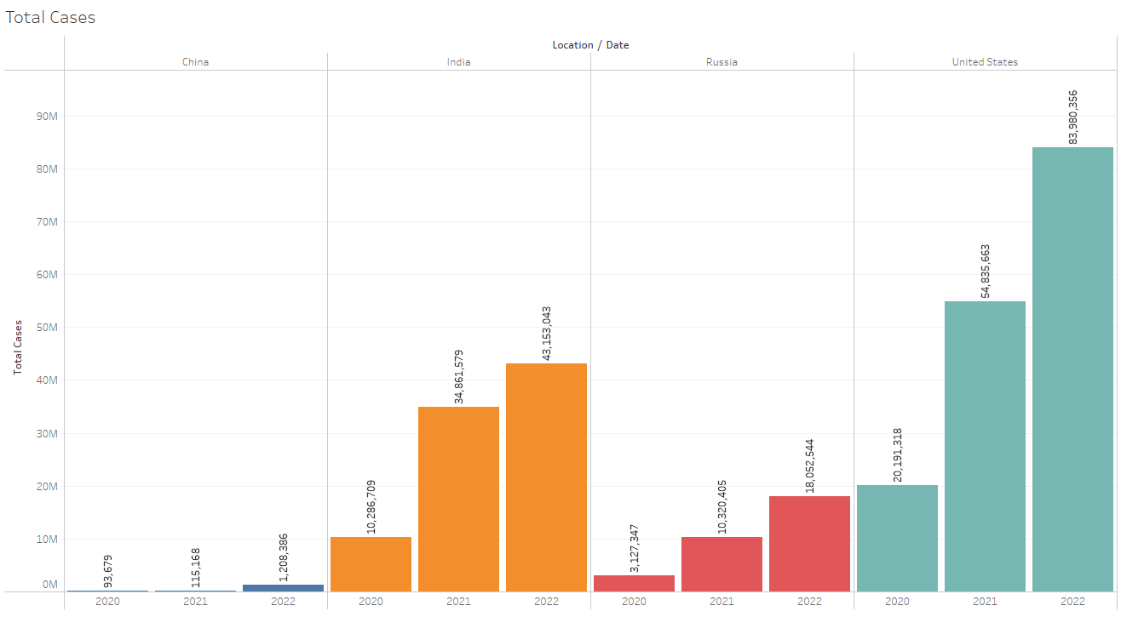
COVID-19 Total Cases

Slide 7
COVID-19 Worldwide Deaths
Worldwide COVID-19 deaths from January 2020 to May 2022

Slide 8
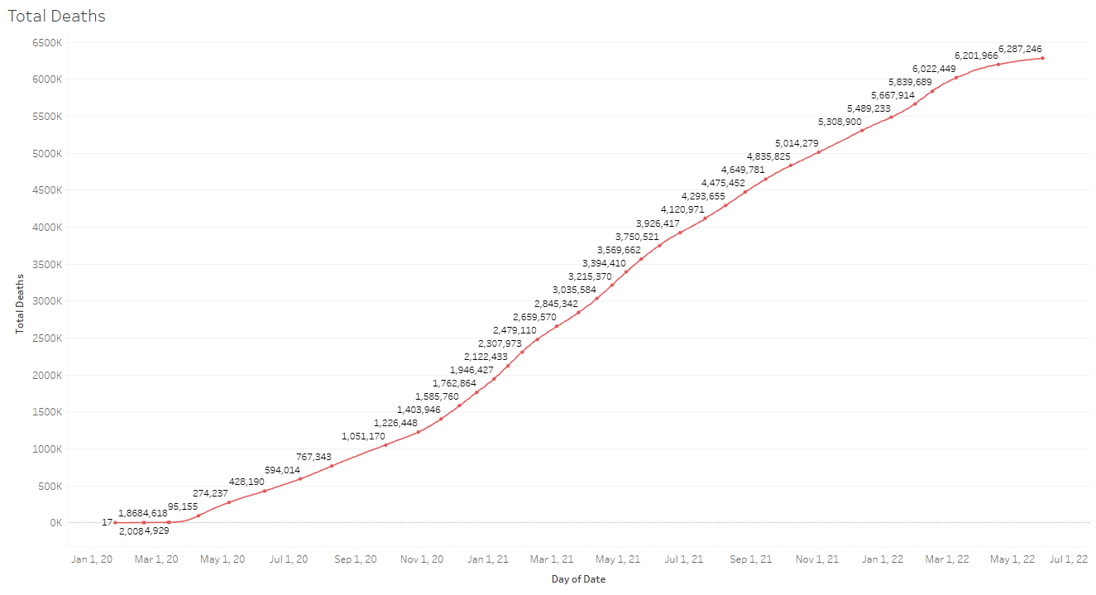
COVID-19 Worldwide Deaths

Slide 9
COVID-19 Total Deaths
COVID-19 Total Deaths in China, India, Russia and USA from 2020 to 2022

Slide 10
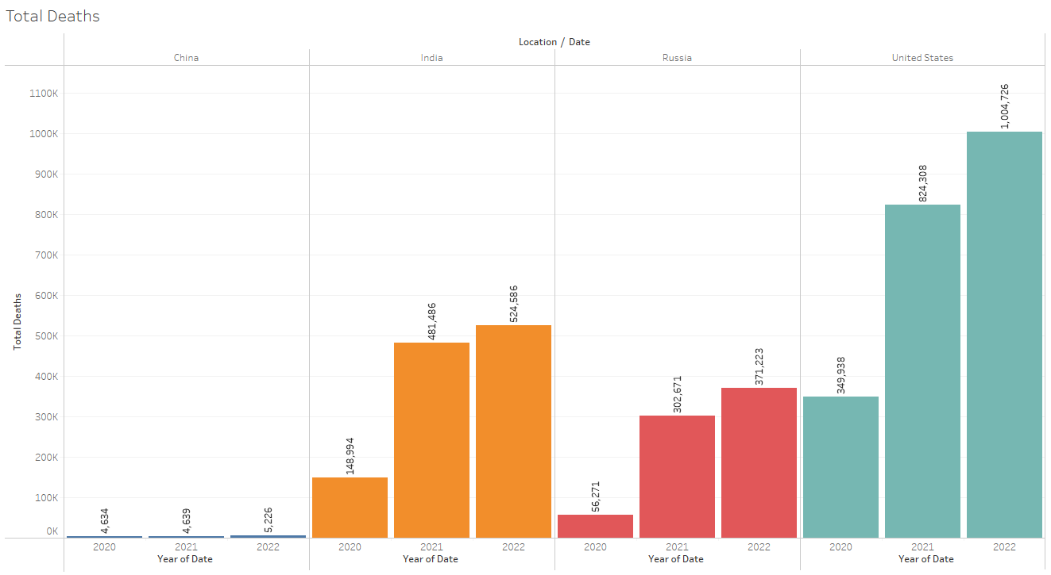
COVID-19 Total Deaths

Slide 11
COVID-19 New Cases (per day avg.)
New COVID-19 Cases (per day avg.) in China, India, Russia and USA from 2020 to 2022

Slide 12
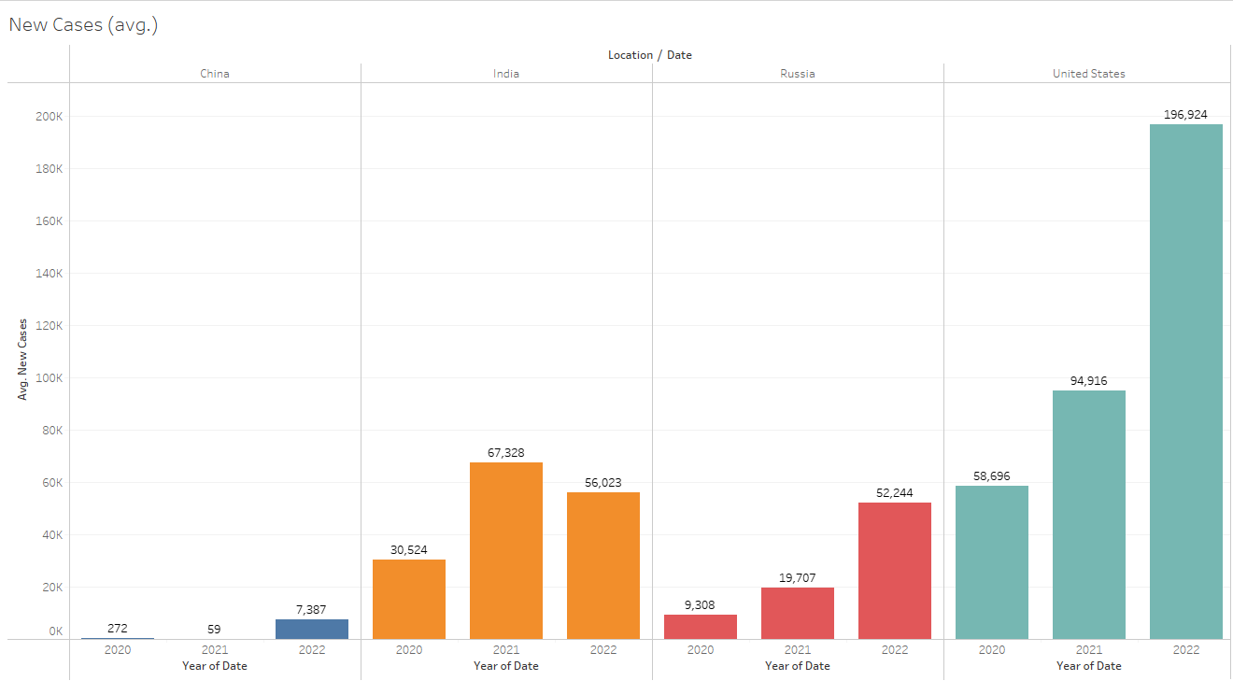
COVID-19 New Cases (per day avg.)

Slide 13
COVID-19 New Cases Per Million (avg.)
New COVID-19 Cases Per Million (avg.) in China, India, Russia & USA from 2020 to 2022

Slide 14
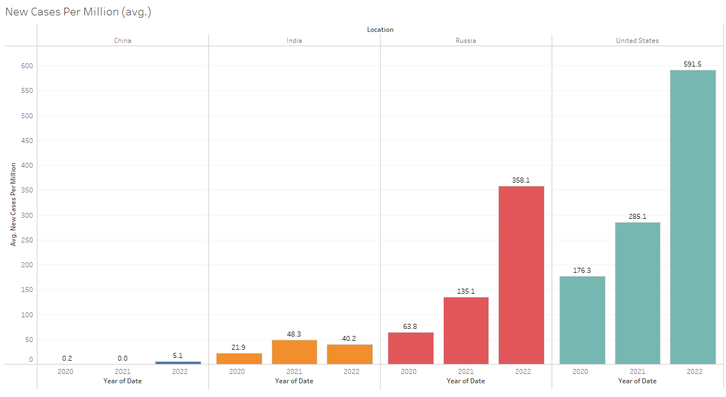
COVID-19 New Cases Per Million (avg.)

Slide 15
COVID-19 New Deaths (per day avg.)
New COVID-19 Deaths (per day avg.) in China, India, Russia & USA from 2020 to 2022

Slide 16
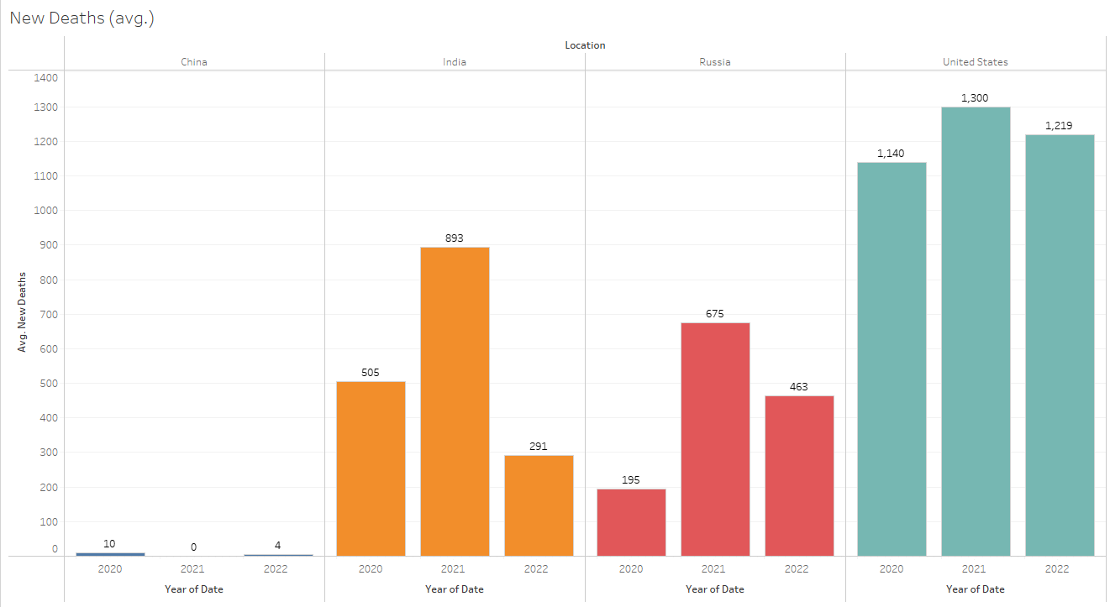
COVID-19 New Deaths (per day avg.)

Slide 17
COVID-19 New Deaths Per Million (avg.)
New COVID-19 Deaths Per Million (avg.) in China, India, Russia & USA from 2020 - 2022

Slide 18
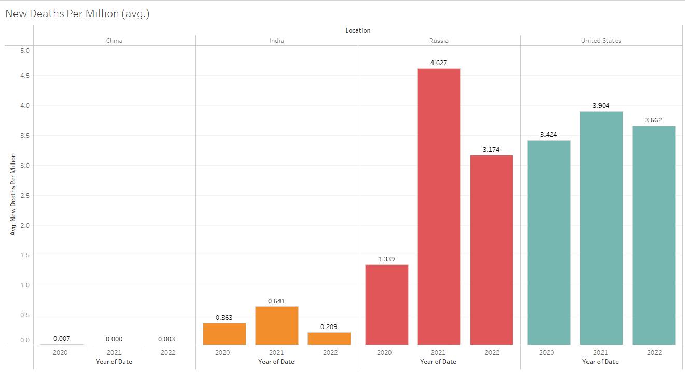
COVID-19 New Deaths Per Million (avg.)

Slide 19
COVID-19 People Fully Vaccinated
People Fully Vaccinated against COVID-19 in China, India, Russia & USA from 2020 - 2022

Slide 20
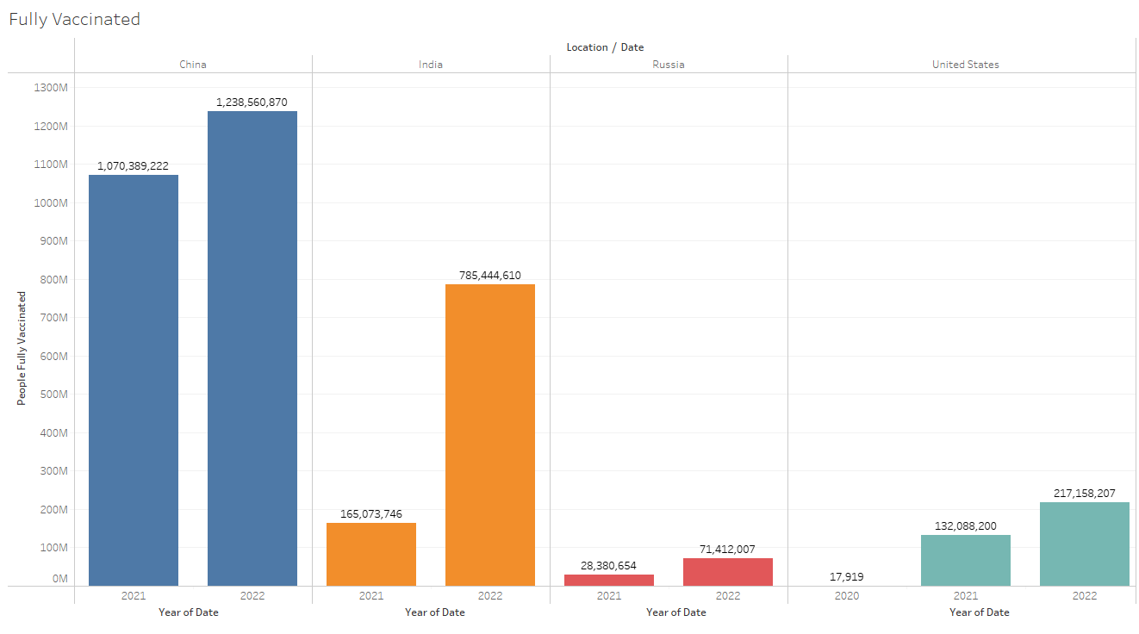
COVID-19 People Fully Vaccinated

Slide 21
COVID-19 People Vaccinated Per Hundred (avg.)
People Vaccinated Per Hundred (avg.) in China, India, Russia & USA from 2020 - 2022

Slide 22
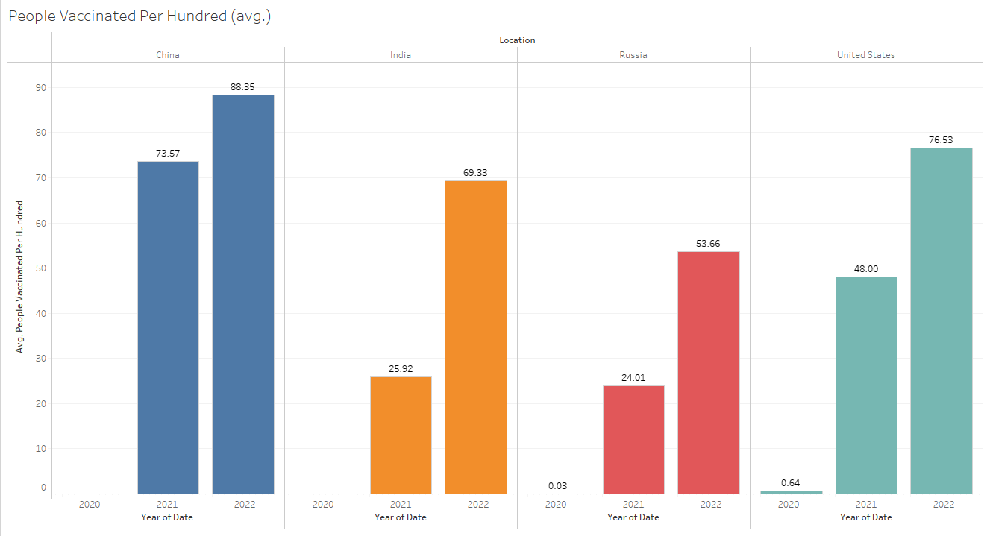
COVID-19 People Vaccinated Per Hundred (avg.)

Slide 23
COVID-19 Stringency Index (avg.)
Stringency Index shows how strict country’s measure were at stage of pandemic spread

Slide 24
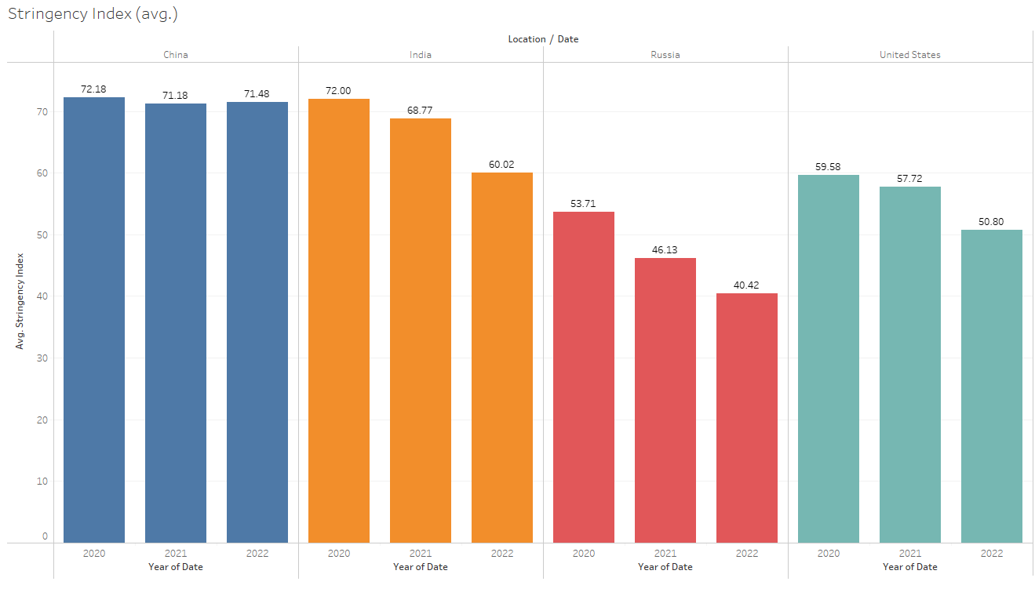
COVID-19 Stringency Index (avg.)

Slide 25
COVID-19 Positive Rate (avg.)
COVID-19 Positive Rate (avg.) in China, India, Russia & USA from 2020 - 2022

Slide 26
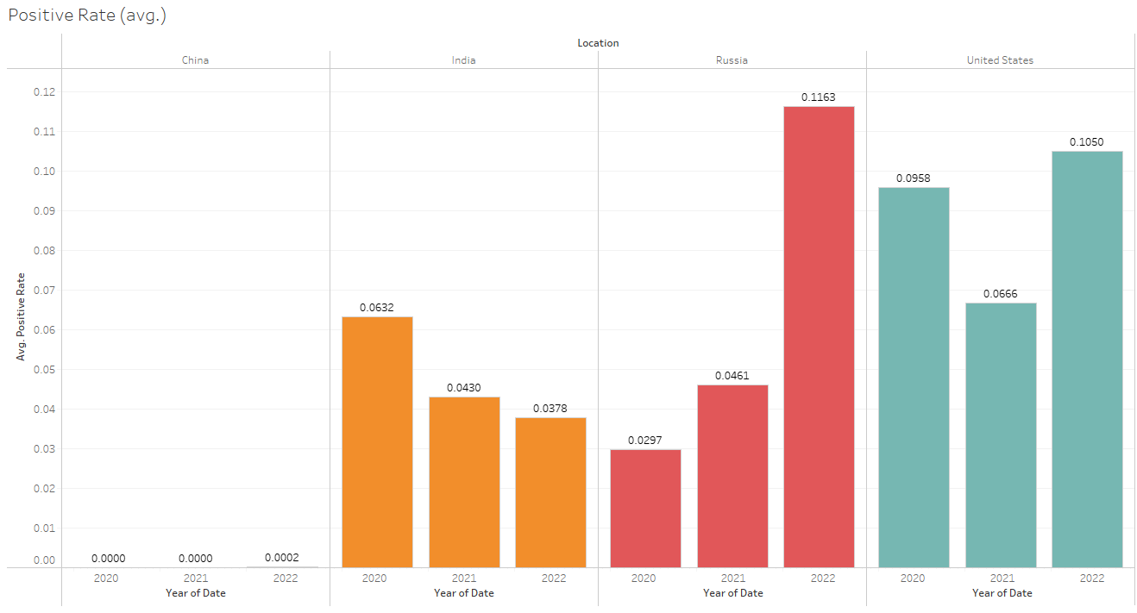
COVID-19 Positive Rate (avg.)

Slide 27
COVID-19 Tests Per Case (avg.)
COVID-19 Test Per Case (avg.) in China, India, Russia & USA from 2020 - 2022

Slide 28
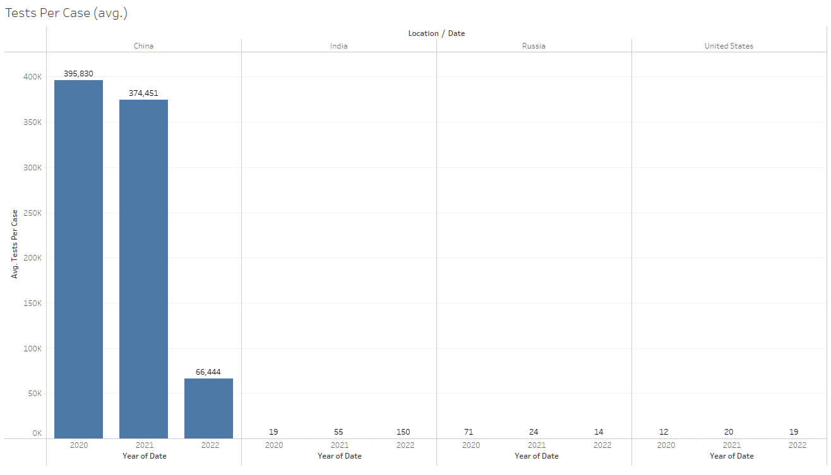
COVID-19 Tests Per Case (avg.)

Slide 29

COVID-19 After-Effects
Reproduction Rate (avg.)
GDP (Trillion USD)
GDP Per Capita (USD)
Healthcare as % of GDP
Currency (in USD)

Slide 30
Reproduction Rate (avg.)
Reproduction Rate (avg.) in China, India, Russia & USA from 2020 - 2022

Slide 31
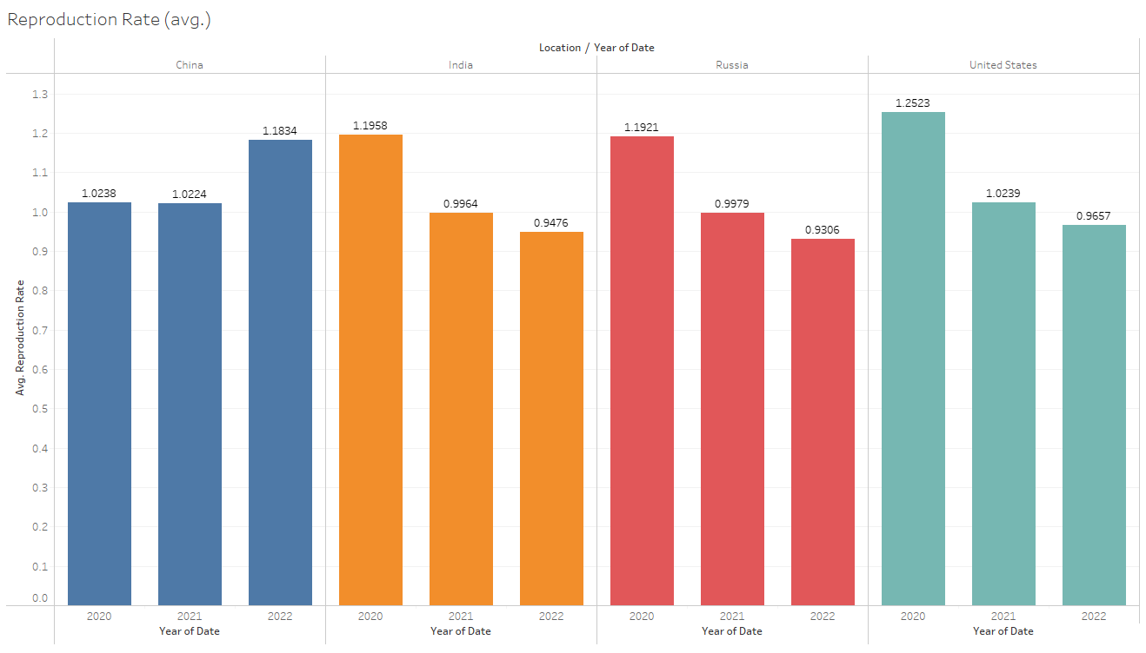
Reproduction Rate (avg.)

Slide 32
GDP (Trillion USD)
GDP (Trillion USD) in China, India, Russia & USA from 2018 - 2021

Slide 33
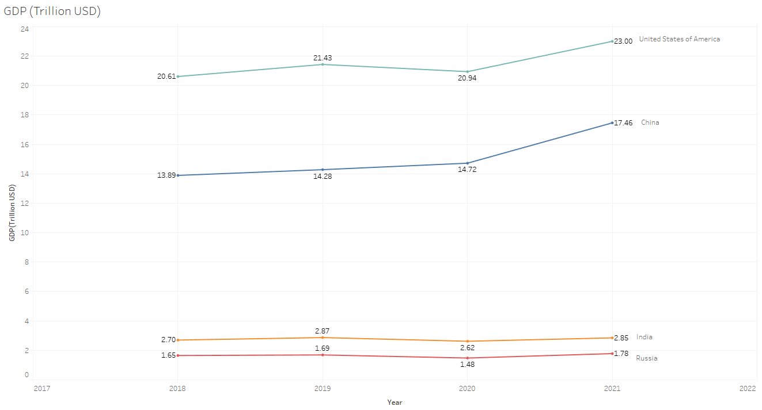
GDP (Trillion USD)

Slide 34
GDP Per Capita (USD)
GDP Per Capita (USD) in China, India, Russia & USA from 2018 - 2021

Slide 35
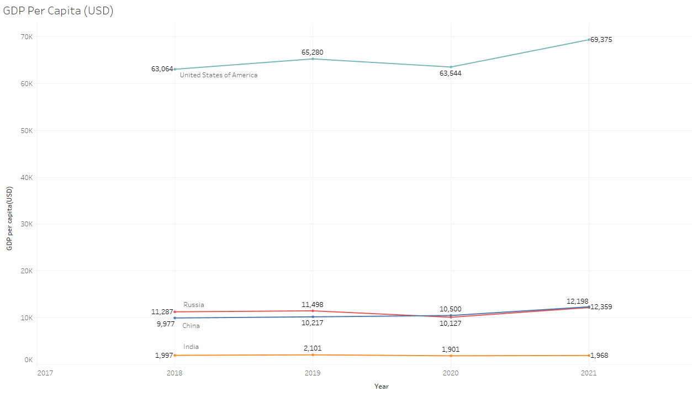
GDP Per Capita (USD)

Slide 36
Healthcare as % of GDP
Healthcare as % of GDP in China, India, Russia & USA from 2018 - 2020

Slide 37
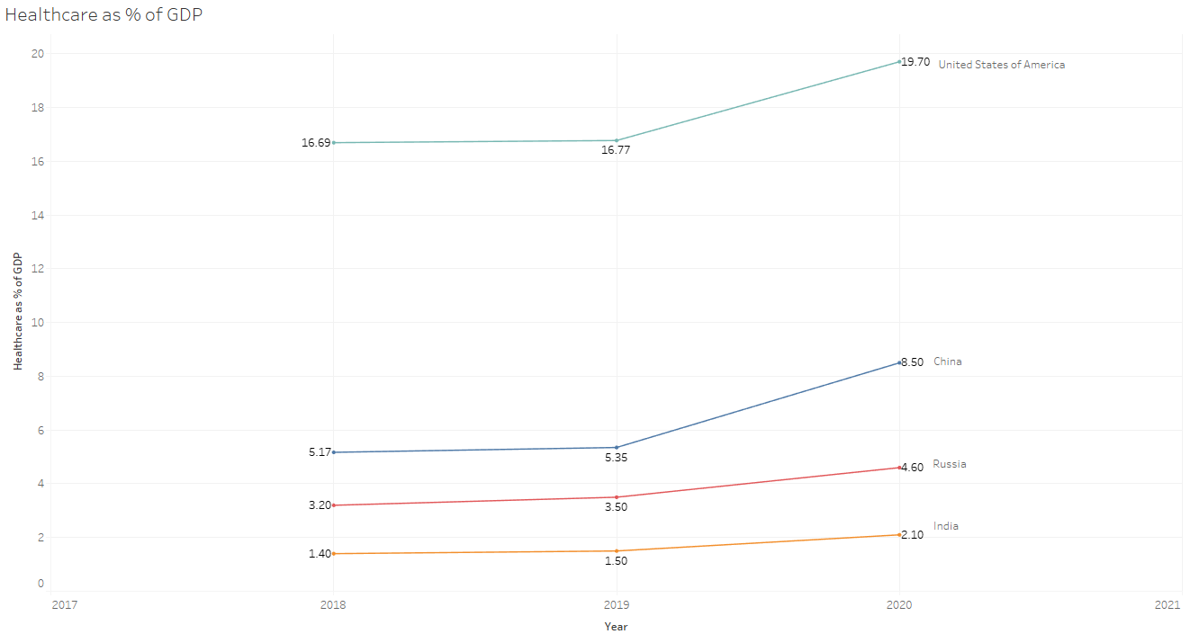
Healthcare as % of GDP

Slide 38
Currency (in USD)
Currency (in GDP) in China, India & Russia from 2019 - 2022

Slide 39
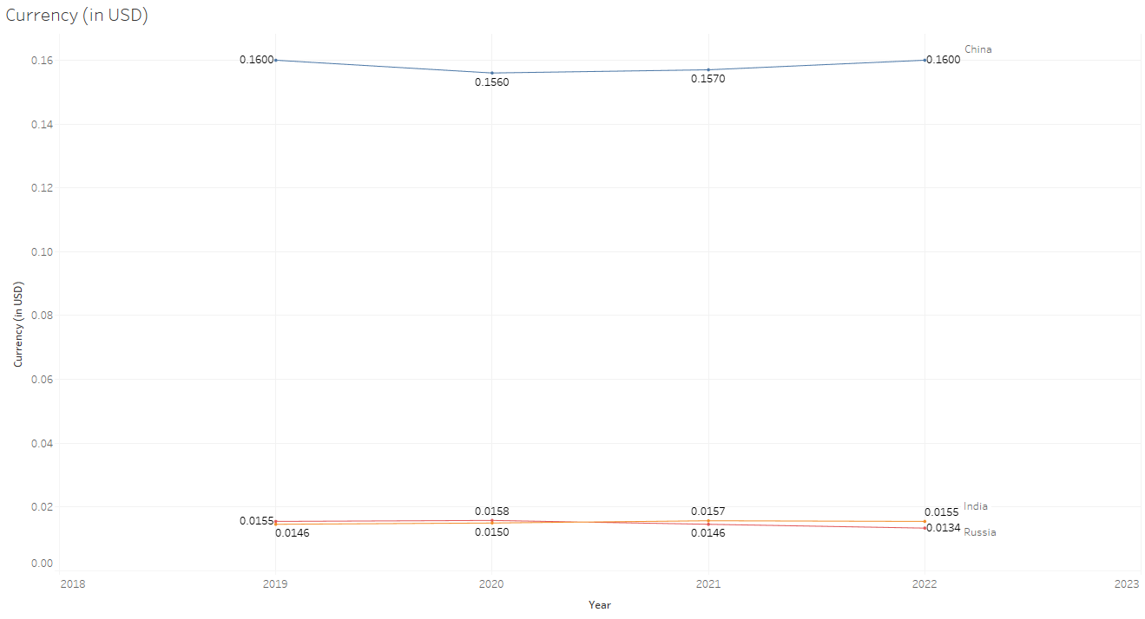
Currency (in USD)

Slide 40

References
https://ourworldindata.org/coronavirus-source-data
https://data.worldbank.org/indicator/NY.GDP.MKTP.CD

